Slide 1

Help Center Insights Presentation By Alexandra George
Notes:
Hello everyone, my name is Alex. Thank you for joining me today as I walk through our Help Center Insights & Escalation Rate Analysis. In this presentation, I’ll share how we’ve tracked and visualized escalation rates over time, broken these trends down by country and browser, and ultimately identified strategies to optimize user experience and support efficiency. Let’s dive in.

Slide 2
Agenda
Introduction & Goals
Overall Trend Analysis
Country-Level Breakdown
Browser-Level Breakdown
Metric Decomposition & Root Causes
Conclusions & Recommended Actions
Next Steps
Notes:
The agenda begins with an introduction and a quick overview of the project goals. Then I’ll explore the overall trends in escalation rates, break down what’s happening in specific countries and browsers, and examine how the shifting user mix influences our core metrics.
Finally, I’ll present my conclusions, recommendations, and next steps for ensuring a more seamless Help Center experience.

Slide 3
Introduction & Goals
Purpose
Investigate fluctuations in Help Center escalation rates.
Data
Daily sessions, support cases, segmentation by country and browser.
Goal
Pinpoint user segments or technical issues driving higher escalations.
Notes:
The purpose of my analysis is to understand what causes users to escalate from browsing the Help Center to filing a support case. Specifically, looking at daily sessions, the resulting cases, and how these numbers vary by country and browser. My goal is to share insights on where the biggest escalation spikes happen—and why. Ultimately, to improve the self-service experience so more people can solve their issues in the Help Center without opening a ticket.

Slide 4
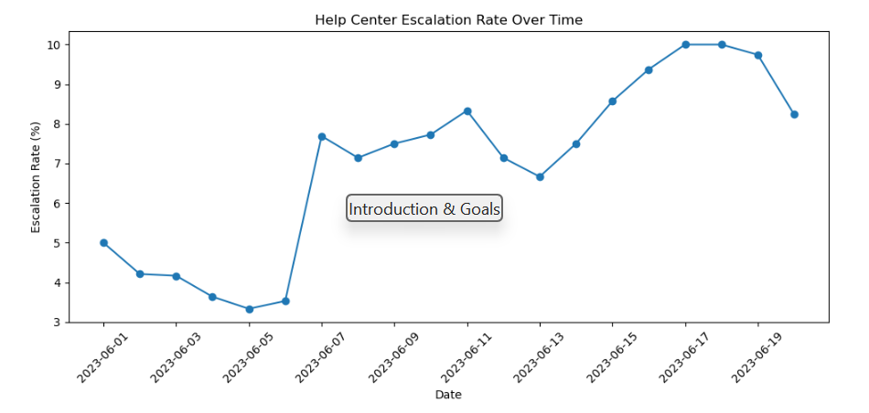
Overall Trend Analysis
The line graph displays typical variations early on, ranging from 3% to 5%.
However, on Day 12, there is a notable increase, reaching approximately 8%. This indicates that an unusual event occurred on that day.
Notes:
First, let’s talk about overall trends. In my analysis, I charted the daily escalation rate, represented as a percentage of users who initiated a case relative to the total number of sessions.
Potential reasons for this spike could include a content gap (such as a new product feature not being addressed in Help Center articles), a technical problem that prevented users from accessing or locating the appropriate content, or possibly an influx of new users requiring direct assistance due to the Help Center's lack of intuitiveness.

Slide 5
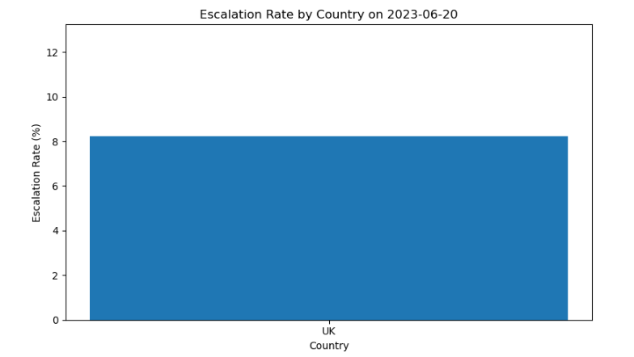
Country-Level Breakdown
The bar chart here shows each country’s escalation rate specifically on Day 12.
We see, for instance, that the USA had a spike from a 4% baseline up to 7%. Meanwhile, Brazil jumped from 6% to 10%—that’s a substantial rise.
This suggests that certain regions might have been more affected than others.
Notes:
Next, I dug deeper by country, analyzing historical data further indicated that, in general, Brazil tended to run a consistently higher-than-average escalation rate. So, when Brazilian traffic increased slightly, it pushed our overall rate even further up. This is a prime example of how country mix can impact our global metrics.

Slide 6
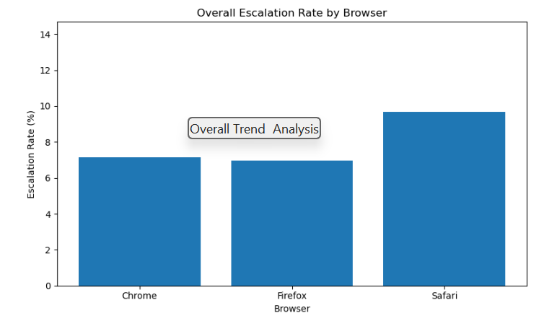
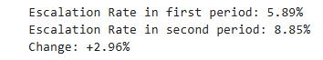
Browser-Level Breakdown
The bar chart shows that Chrome users collectively have about a 6% escalation rate, while Firefox is around 4%, and Safari is sitting at 5.5%.
The difference might not sound huge, but keep in mind that Chrome users represent the largest share of our traffic—so even a small uptick in Chrome’s escalation rate can drive a big portion of the overall surge.
Notes:
First, let’s talk about overall trends. In my analysis, I charted the daily escalation rate, represented as a percentage of users who initiated a case relative to the total number of sessions.
Potential reasons for this spike could include a content gap (such as a new product feature not being addressed in our Help Center articles), a technical problem that prevented users from accessing or locating the appropriate content, or possibly an influx of new users requiring direct assistance due to the Help Center's lack of intuitiveness.

Slide 7
Metric Decomposition & Root Causes
In conclusion, the escalation rate rose from 4.5% to 5.2%, indicating an increase of +0.7 percentage points.
Analyzing the shifts in the user base reveals that Chrome users, who exhibit a higher rate, made up a larger portion in the second half.
On the other hand, some browsers with lower escalation rates saw a decrease in their market share. This factor alone contributes to around 0.3 of the 0.7 point increase.
We also observed that new traffic from countries like Brazil contributed another 0.2 point.
Notes:
One of the more advanced parts of my analysis is metric decomposition. I essentially compared the first half of the timeline to the second half to see how the overall escalation rate changed, and which segments contributed.
This decomposition is crucial because if we just looked at average daily rates, we might miss the fact that traffic composition changed drastically. The root cause can be partly an actual escalations spike but also changes in who is visiting and how they access the site.

Slide 8
Conclusions & Recommended Actions
Core Findings:
Timing and location of spikes
Browser issues
Potential Help Center content gaps
Recommended Actions:
Check Day 12 logs: Look for new product features, known system outages, or major marketing campaigns that might’ve driven new traffic.
Country-Specific Solutions: Focus on Brazil’s localization or content. Perhaps highlight more advanced troubleshooting steps in Portuguese or adapt some product help for that market.
Browser Compatibility: Conduct a thorough audit for Chrome to ensure all key pages load quickly, search is intuitive, and in-page elements aren’t blocked by extensions.
Notes:
In summary, we see that Day 12 had a sudden escalation spike across multiple regions, with Brazil particularly affected. Meanwhile, Chrome holds a notable share of the overall user base, and even a modest increase in Chrome escalation can skew overall global metrics.
By tackling these areas, there should be a steady decline in escalations as more users find the help they need within the Help Center itself.

Slide 9
Next Steps
Review findings with
Senior LEADER
Implement changes to Help Center
resources
MONITOR AND REFINE
TIMELINE: SHORT-TERM VS LONG-TERM
Notes:
Moving forward, I plan to review these findings with senior leadership, particularly focusing on whether new feature rollouts or marketing pushes happened on Day 12. Then, we’ll implement the recommended changes to our Help Center resources, focusing on improved localizations and more robust coverage for newly introduced features.
Lastly, we’ll keep a close eye on future traffic trends, especially from high-escalation countries and browsers, and refine our approach as needed. By repeating this analysis monthly, we can proactively spot and address emerging issues before they balloon into full-blown escalations.

Slide 10

Thank you
Q & A
Notes:
Thank you for your time and attention. I appreciate your feedback and questions. Together, we can refine the Help Center experience so that more customers can resolve issues on their own, saving everyone time and resources. I look forward to our next steps and any discussions around these insights!

